Slide 1


CSI Business & Ecosystems Training
DAY 1
Bette Harms
Advisor Business & Biodiversity
Coordinator Leaders for Nature Academy

Slide 2
Session 1
Icebreaker and Introduction

Slide 3
Icebreaker and Introduction (cont.)
      Your current role and scope of work
      Your knowledge of biodiversity & ecosystems
      What you want to learn from the course
  2 minutes

Slide 4


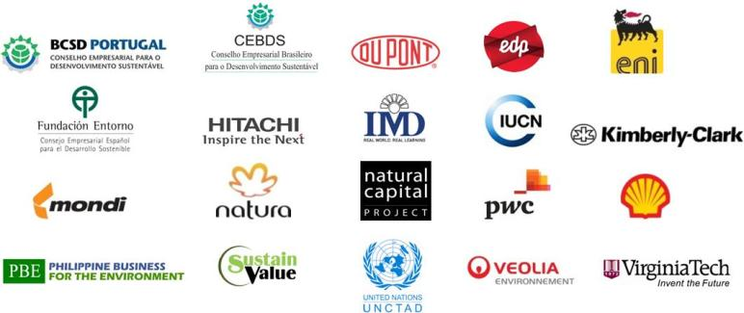
Business Ecosystems Training – Contributors
The content is based on material and publically available reports.
BET curriculum and structure was designed by
The structure and content development of BET was governed by an Advisory Committee consisting of WBCSD member companies and Regional Network partners, NGOs, UN and academic institutions.

Slide 5
Where do module 1 & 2 sit within the broader training available?
Module 1:
Understanding the links between ecosystem services and business
Module 2:
Measuring and assessing impacts and dependencies
Module 4:
Managing and mitigating impacts
Module 3:
Introduction to valuing ecosystem services

Slide 6
Session 2
Biodiversity, Ecosystems and Ecosystem Services – the basics

Slide 7
Not another nature film
Notes:
vimeo.com/15875925
7

Slide 8


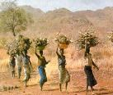
A few definitions
Biodiversity
  The variability among living organisms within species and ecosystems.
Ecosystem
    A dynamic complex of plant, animal, and micro-organism communities and the non-living environment.
Ecosystem services
    The benefits that people obtain from ecosystems – the goods and services of nature.
    Natural capital
    Natural Capital can be defined as the world’s stocks of natural assets which include geology, soil, air, water and all living things.

Slide 9
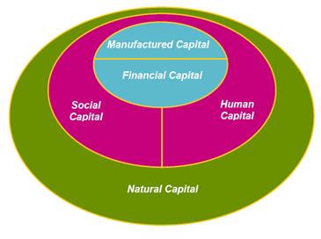
Natural capital
Natural capital is the extension of the economic notion of capital (manufactured means of production) to goods and services relating to the natural environment.
Notes:
Natural Capital can be defined as the world’s stocks of natural assets which include geology, soil, air, water and all living things (biodiversity).

Slide 10

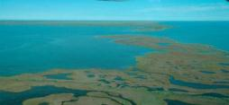



Biodiversity is not just about:
But also about:

Slide 11
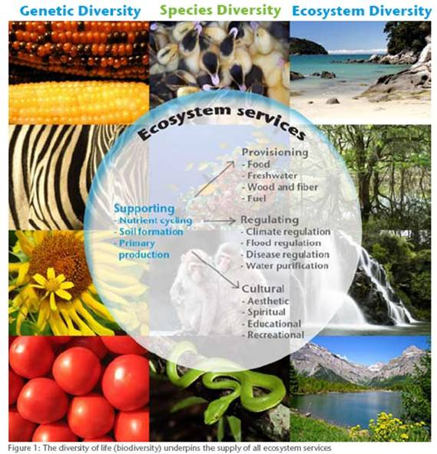
Notes:
We will focus on this last one as this is of most relevance and accesible for companies.
Group ecosystem services into four main categories.
This framework has been developed by the Millenium Ecosystems Assessement, and is now internationally recognised and used (with minor variations)
Uniting all of these three concepts and visualising biodiversity (genetic, species and ecosystem levels) and ecosystem services.
Biodiversity underpins the provision of ecosystem services.
In general, as biodiversity declines, so does the quantity and quality of ecosystem services.

Slide 12
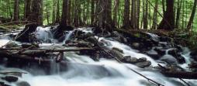





Ecosystem services – an overview
Provisioning
Goods or products produced by ecosystems
Regulating
Natural processes regulated by ecosystems
Cultural
Intangible benefits obtained from ecosystems
Supporting
Functions that maintain all other services
As described in the Millennium Ecosystem Assessment, 2005.

Slide 13
SESSION 3
THE GLOBAL ECOSYSTEM CHALLENGE

Slide 14
The global ecosystem challenge
Meeting the dual goals of sustainability
High human development and low ecological impact
Source: © Global Footprint Network (2009). Data from Global Footprint Network National Footprint Accounts, 2009 Edition; UNDP Human Development Report, 2009
Notes:
This chart sums up the challenge of sustainable development: meeting human demands within the ecological limits of the planet. It is a snapshot showing how different countries perform according to the United Nations Development Programme’s (UNDP) Human Development Index (HDI) and Global Footprint Network’s Ecological Footprint. In countries to the left of the vertical line marking a score of less than 0.8 on the HDI, a high level of development, as defined by UNDP, has not been attained. Countries above the horizontal dotted line and to the right of the vertical line have achieved a high level of development but place more demand on nature than could be sustained if everyone in the world lived this way. In order to move toward a sustainable future the world will need to address all dimensions of this chart – the concepts of success and progress, the biocapacity available per person, as well as helping countries either improve their levels of development or reduce their ecological impact (several countries face both challenges).

Slide 15
Link between ecosystem services and human well-being
Ecosystem Service
Constituents of Well-Being
Supporting
    Nutrient Cycling
    Soil Formation
    Primary Production
    ...
Provisioning
    Food
    Fresh Water
    Wood and Fiber
    Fuel
    ...
Security
    Personal safety
    Secure resource access
    Security from disasters
Freedom of choice and action
    Opportunity to be able to achieve what an individual values doing and being
Basic material for good life
    Adequate livelihoods
    Sufficient nutritious food
    Shelter
    Access to goods
Regulating
    Climate Regulation
    Flood Regulation
    Disease Regulation
    Water Purification
    ...
Health
    Strength
    Feeling well
    Access to clean air and water
Cultural
    Aesthetic
    Spiritual
    Educational
    Recreational
    ...
Good social relations
    Social cohesion
    Mutual respect
    Ability to help others
Life on Earth – Biodiversity
Source: Millennium Ecosystem Assessment
Arrow’s Color
Potential for mediation by
socioeconomic factors
Arrow’s Width
Intensity of linkages between ecosystem
services and human well-being
Key:  Low  Medium  High
Key:  Week  Medium  Strong
Source: Millennium Ecosystem Assessment, Synthesis
Notes:
Developed by the Millennium Ecosystem Assessment, this chart illustrates the interlinkages between ecosystem services (provisioning, regulating, cultural, supporting) and the constituents of human well-being (security, basic materials for good life, health, good social relations, freedom of choice and action).
Synergies and tradeoffs also exist within the ecosystem services box and the constituents of human well-being box. Increasing or decreasing the supply of one ecosystem service might affect the supply of another service, and improving or deteriorating one constituent of human well-being might affect another.
Source: Millennium Ecosystem Assessment, 2005.

Slide 16
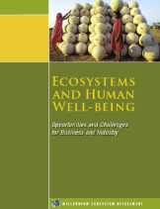
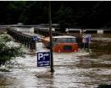
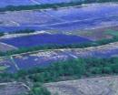


Current situation biodiversity & ecosystems
      Many of the world’s ecosystems are in serious decline
      Continuing supply of critical ecosystem services like water purification, pollination and climate regulation are in jeopardy
      5 main drivers for biodiversity loss and ecosystem degradation
Climate
change
Habitat
change
Invasive species
Over-
exploitation
Pollution
    Sources: WBCSD, Connecting the dots presentation
    Millennium Ecosystem Assessment, 2005. Ecosystems and Human Well-being: Opportunities and Challenges for Business and Industry
Notes:
Facilitator to talk through the main drivers of change identified in the MEA:
By the end of the century, climate change and its impacts may be the dominant direct driver of biodiversity loss and changes in ecosystem services globally,
Harm to biodiversity will grow worldwide with increasing rates of change in climate and increasing absolute amounts of change,
Some ecosystem services in some regions may initially be enhanced by projected changes in climate. As climate change becomes more severe the harmful impacts outweigh the benefits in most regions of the world.
Facilitator to mention that there are inter-linkages between these drivers and that this may lead to cumulative damages.
The balance of scientific evidence suggests that there will be a significant net harmful impact on ecosystem services worldwide if the global mean surface temperature increases more than 2o C above preindustrial levels (medium certainty). This would require CO2 stabilization at less than 450 parts per million, a target needed to keep climate change at bay.
Ecosystems have declined more rapidly and extensively over the past 50 years than at any other comparable time in human history.
In fact, 15 of the 24 ecosystem services evaluated have degraded over the past half century. The Assessment projected further declines over the coming decades, particularly in light of population growth, economic expansion and global climate change.
Left unchecked, this degradation could jeopardize future economic well-being, creating new winners and losers within the business community.
Source: Millennium Ecosystem Assessment, 2005.
Initiated in 2001 by Kofi Annan (SG of UN), the objective of the The Millennium Ecosystem Assessment (MA) was to assess the consequences of ecosystem change for human well-being and the scientific basis for action needed to enhance the conservation and sustainable use of those systems and their contribution to human well-being.
The MA has involved the work of more than 1,360 experts worldwide. Their findings, contained in five technical volumes and six synthesis reports, provide a state-of-the-art scientific appraisal of the condition and trends in the world’s ecosystems and the services they provide (such as clean water, food, forest products, flood control, and natural resources) and the options to restore, conserve or enhance the sustainable use of ecosystems. It is the largest global audit of nature.
It concludes that human activity is having a significant and escalating impact on the biodiversity of world ecosystems, reducing both their resilience and biocapacity. The report refers to natural systems as humanity's "life-support system", providing essential "ecosystem services". The assessment measures 24 ecosystem services concluding that only four have shown improvement over the last 50 years, fifteen are in serious decline, and five are in a stable state overall, but under threat in some parts of the world.
[Ecosystems have declined more rapidly and extensively over the past 50 years than at any other comparable time in human history. Left unchecked, this degradation could jeopardize future economic well-being, creating new winners and losers within the business community.]
16

Slide 17
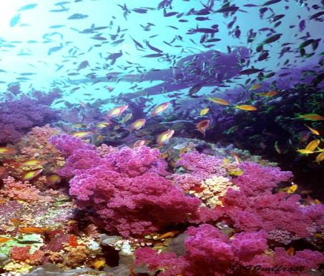
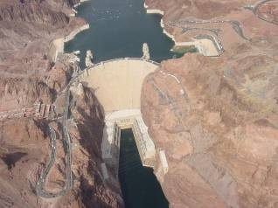
The MA’s major finding regarding ecosystems
      The structure and functioning of the world’s ecosystems has changed rapidly the past 50 years
      20% of the world’s coral reefs have been lost and more than 20% are degraded
      35% of mangrove area has been lost in the last several decades
      Amount of water in reservoirs quadrupled since 1960
      Withdrawals from rivers and lakes doubled since 1960
    Source: Millennium Ecosystem Assessment, 2005.
Notes:
1.Over the past 50 years, humans have changed ecosystems more rapidly and extensively than in any comparable period of time in human history, largely to meet rapidly growing demands for food, fresh water, timber, fiber, and fuel. This has resulted in a substantial and largely irreversible loss in the diversity of life on Earth.
2.The changes that have been made to ecosystems have contributed to substantial net gains in human well-being and economic development, but these gains have been achieved at growing costs in the form of the degradation of many ecosystem services, increased risks of nonlinear changes, and the exacerbation of poverty for some groups of people. These problems, unless addressed, will substantially diminish the benefits
3.“The degradation of ecosystem services could grow significantly worse during the first half of this century and is a barrier to achieving the Millennium Development Goals.
4.The challenge of reversing the degradation of ecosystems while meeting increasing demands for their services can be partially met under some scenarios that the MA has considered, but these involve significant changes in policies, institutions, and practices that are not currently under way. Many options exist to conserve or enhance specific ecosystem services in ways that reduce negative trade-offs or that provide positive synergies with other ecosystem services.”

Slide 18

CLARIFICATIONS AND QUESTIONS

Slide 19

Lunch

Slide 20
SESSION 4
RESPONSES TO THE GLOBAL ECOSYSTEM
CHALLENGE

Slide 21
External responses: policies and legislation
Long history of environmental regulation
      1388 UK water pollution measures
      1973 EU Action Programme on the Environment / Water
The limits to growth (1972)
      Modelled world population, industrialization, pollution, food production and resource depletion
Brundtland Report (1987)
      Defined sustainable development
      Called for increased international cooperation
Conventions, treaties, protocols, agreements…
      Over 250 multilateral environmental agreements exist
The Earth Summit (1992) – start of ‘The Rio Process’
Notes:
1388 UK: regulating waste dumping into rivers
Several studies at the basis of environmental policy and legislation
Limits to growth: study about future of our planet, scenario analysis of global developments, already showing that strict environmental policies are necessary
Limits to Growth is a study about the future of our planet. It involved designing a computing model which took into account the relations between various global developments and produced computer simulations for alternative scenarios. Part of the modelling were different amounts of possibly available resources, different levels of agricultural productivity, birth control or environmental protection.
Brundtland: introduced term sustainable development, showing that we exceed carrying capacity of the planet.
Earth summit: first global environmental conference to rethink economic development and halt loss of natural resources, Rio+20: important role of business community

Slide 22
Background to ecosystem policy
The Earth Summit (1992)
Agenda 21
Framework Convention on Climate Change (UNFCCC)
Convention on Biological Diversity (CBD)
Statement of Principles on the Management and Conservation of the World’s Forests
+ IPCC
+ IPBES
Other significant multi-lateral environmental agreements:
Ramsar Convention
(Wetlands)
1971
Convention on International Trade in Endangered Species (CITES)
1998
Montreal Protocol (Ozone depletion)
1987
Rotterdam Convention (Hazardous Chemicals)
1998
Basel Convention (Hazardous Waste)
1989
Stockholm Convention (Persistent Organic Pollutants)
2001
Notes:
Examples of environmental conventions and multi lateral agreements, many translated into national legislation
CBD goals: 1) conservation of biological diversity, 2) sustainable use of its components, 3) fair and equitable sharing of benefits arising from genetic resources

Slide 23
International policy trends – Introduction to the CBD
Issue recognition –heightened concern over damage / loss of species and ecosystems (1970s)
International response – CBD established at ‘Earth Summit’ (Rio 1992); COP10 Strategy plan (Nagoya 2010)
Mitigation – ongoing
National response –
Aichi targets, EU Biodiversity Action Plan
Impact on industry – complying with standards (ISO); innovative solutions; change of business of usual
Notes:
Issue recognition: heightened concern over damage / loss of species and ecosystems (1970s)
International response: Convention on Biological Diversity established at UN ‗Earth Summit‘ (Rio 1992); the 10th Conference of the Parties (COP 10) in Nagoya 2010 set out the key objectives:
1.The conservation of biological diversity
2.The sustainable use of the components of biological diversity
3.The fair and equitable sharing of the benefits arising from the utilization of genetic resources
These objectives are part of the 5 strategic goals, which dictate the 20 headline targets (so called Aichi targets for 2020).
National response: signatories translate these targets into national laws, e.g. EU Biodiversity Action Plan
20 Aichi targets key elements of the strategic plan 2010-2020, these targets influence business
Target 2: By 2020, at the latest, biodiversity values have been integrated into national and local development and poverty reduction strategies and planning processes and are being incorporated into national accounting, as appropriate, and reporting systems
Target 3: By 2020, at the latest, incentives, including subsidies, harmful to biodiversity are eliminated, phased out or reformed in order to minimize or avoid negative impacts, and positive incentives for the conservation and sustainable use of biodiversity are developed and applied
Target 4: By 2020, at the latest, Governments, business and stakeholders at all levels have taken steps to achieve or have implemented plans for sustainable production and consumption and have kept the impacts of use of natural resources well within safe ecological limits.
EU biodiversity plan: No Net Loss

Slide 24
External responses: Finance
Examples:
      IFC Performance Standards
        Mentioned in 5 standards; main focus in Performance standard 6: Biodiversity Conservation and Sustainable Natural Resource Management
      Equator principles
        The Equator Principles is a credit risk management framework for determining, assessing and managing environmental and social risk in project finance transactions
      Natural Capital Declaration
        A declaration by the financial sector demonstrating their commitment to work towards integrating natural capital considerations into financial products and services
Source: IFC Performance Standard 6, January 2012.
Notes:
The EPs are adopted by financial institutions and are applied where total project capital costs exceed US$10 million. The EPs are primarily intended to provide a minimum standard for due diligence to support responsible risk decision-making.
The EPs are based on the International Finance Corporation Performance Standards on social and environmental sustainability and on the World Bank Group Environmental, Health, and Safety Guidelines (EHS Guidelines).
Equator Principles Financial Institutions (EPFIs) commit to not providing loans to projects where the borrower will not or is unable to comply with their respective social and environmental policies and procedures.
IFC: Biodiversity and sustainable use of natural resources part of IFC performance standards, Applied during environmental and social risks and impacts identification process
EP: based on the IFC performance standards and applied where total project capital costs exceed US$10 million, they provide a minimum standard for due diligence to support responsible risk decision-making, not providing loans to projects where the borrower will not or is unable to comply with their respective social and environmental policies and procedures.
NCD: signed by over 40 CEOs from financial institutes, to create conditions to maintain natural capital: disclose impacts and dependencies, support development of methodologies to integrate natural capital in decision making, include natural capital in risk analysis, integrated reporting and accounting

Slide 25
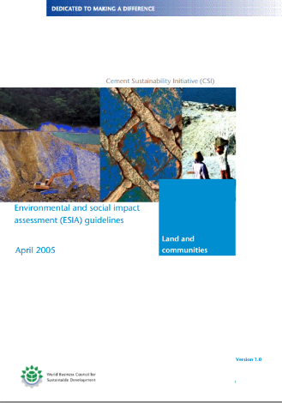
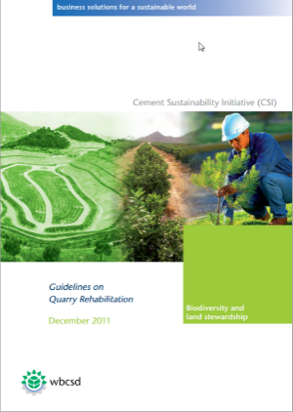

Task Force 5: Milestones to date
2005 ESIA Guidelines
  Concise guidelines to enable cement companies & local communities to identify & address some of the critical issues during each phase of a cement facility's development, operation and eventual closure:
2011 Quarry Rehabilitation Guidelines
  A clear set of recommendations for the development & implementation of a quarry rehabilitation plan.
  (Available in 6 languages)
2012 IBAT ‘Road-test’
  Integrated Biodiversity Assessment Tool (IBAT) for business – a decision-support system designed for private sector users to support fine-scale risk assessment across the globe i.e. biodiversity screening.

Slide 26
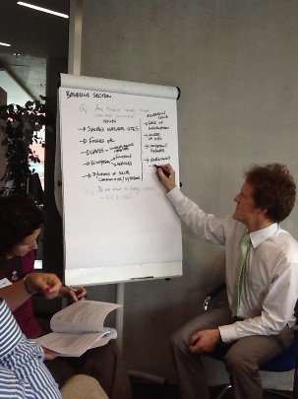
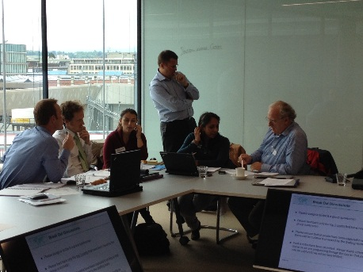
Task Force 5: Workstreams
1. Biodiversity Management Plan (BMP) Guidance
Aim: To guide companies through the steps for developing a plan to manage biodiversity at their sites
Status: Draft completed. Review, editing & design phase
Delivery: July 2014
2. ESIA Guidelines Review
Aim: To update the 2005 guidance & provide advice on how to undertake a full environmental & social impact assessment (ESIA)
How integrate ESIA results into site planning &management
Status: Roundtable with experts, Apr 29. Feedback consolidation & document revision
Delivery: July 2014
Notes:
BMP
Drafted by TF5 members
Externally reviewed; then revised and updated
Input from WBCSD Ecosystems Focus Area
Provides a practical, step-by-step guide for users
Links to other key references and information resources
Part of CSI member ‘toolkit’
Completion by end 2013
Extends focus to include more of quarry life cycle

Slide 27
Case study Exercise on Mapping impacts and dependencies on natural capital
Notes:
1 hour

Slide 28
How can ecosystem service assessments help?
      Effective communication of complex and technical information
      Better informed decision-making
Identifying and prioritising business risks and opportunities
      Anticipating new markets and influencing policy development
      Improving stakeholder relationships
      Strengthening environmental management
Demonstrating leadership in corporate sustainability
Source: WRI, Ecosystem Services Review Standard Presentation

Slide 29
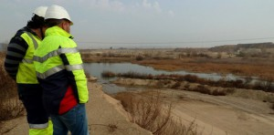
Case study: Cemex – ESR for quarry rehabilitation
Scope
      100 hectare gravel pit in France – farmland and forest area
      focus on quarry operation and rehabilitation over 25 years
      Worked with Ligue pour la Protection des Oiseaux (LPO) - their French Birdlife International partner.
Before
After

Slide 30
Ecosystems: identifying key ecosystem services
  Please discuss in groups:
  Cemex decided to implement a strategy to manage their impacts and dependencies on biodiversity/ecosystem services.
  In your groups, discuss the following questions:
      What ecosystems and ecosystem services apply to this case study?
      What are Cemex’s ecosystem service impacts/dependencies?
      Based on your answers to 1 and 2, how can Cemex start to address their impacts and dependencies?
    30 minutes
Notes:
Plenary in pairs
30

Slide 31
Concepts
      Ecosystem Dependency: “Ecosystem conditions required for successful corporate performance”, e.g. the agricultural industry is dependent on plant pollinator species such as bees.
      Ecosystem Priority: “those services on which the company has a high dependence and/or impact”, e.g. the paper industry impacts on forests by procuring timber for their products.
      Ecosystem Impact: “Company affects the quantity or quality of the ecosystem service”, e.g. mining industry has an impact on ecosystems that exist on the land occupied by extraction sites.
    Source: Connecting the dots (slide 9) and WBCSD. 2008. Corporate Ecosystem Services Review [online]. [Accessed 2 August 2011]. Available from: http://www.wbcsd.org/DocRoot/R3HpfX53CixLEiQsBRpJ/Corporate_Ecosystem_Services_Review.pdf

Slide 32
Exercise identifying key ecosystem services
Impacts and dependencies on ecosystem services
 | SCOPE |  | SCOPE |  | SCOPE
Key Ecosystem Services | DEPEND | IMPACT | DEPEND | IMPACT | DEPEND | IMPACT
Provisioning
Food
Timber and fibres
Freshwater
Genetic / Pharmaceutical resources
Regulating
Climate & air quality regulation
Water regulation & purification
Pollination
Shoreline protection
Cultural
Recreation & tourism
Aesthetic / non-use values
Spiritual values
3 Moderate to Major relevance 1 Minor relevance 0 No relevance
Note: “Supporting services” are not included in this table as they are already captured within provisioning, regulating and cultural services.

Slide 33
Case study: Cemex (cont)
Priority ecosystem services
      Key ES were:
        Crop production – negative impact at start of quarrying – positive impact after rehabilitation
        Freshwater – dependent for aggregate production process and impacts through quarries filling with water
        Recreation – potential to enhance recreation by developing walkways, fishing and boating activities
        Global and regional climate change impacts – diesel quarrying equipment and land cover changes
        Ethical values - potential negative impacts from alien species and positive impacts from creating wetland habitat
Before
After

Slide 34
Case study: Cemex (cont)
      The result
      Provide technical assistance (e.g. to farmers) to improve watershed health (e.g. from reduced chemical and nutrient run-off)
      Increase invasive species control
      Enhance ES that underpin local tourism
      Quantify carbon benefits of restoration (as quarry rehabilitation has positive effect on GHG)
Before
After

Slide 35
SESSION 5
THE BUSINESS CASE FOR ACTION

Slide 36
Mother Nature’s Invoice
Notes:
Film: http://vimeo.com/16961590
1.30 min

Slide 37
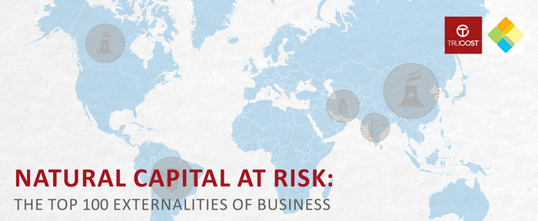
Natural Capital at risk
The primary production and primary processing sectors analyzed are estimated to have externality costs totaling US$7.3 trillion, which equates to 13% of global economic output in 2009
The majority of environmental externality costs are from greenhouse gas emissions (38%) followed by water use (25%); land use (24%); air pollution (7%), land and water pollution (5%) and waste (1%).
Notes:
Source:http://www.naturalcapitalcoalition.org/about/how/natural-capital-risk.html

Slide 38
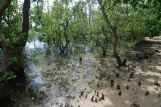
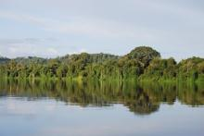
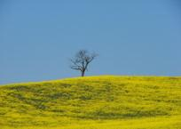
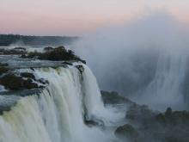
Business case for action
Businesses impact on ecosystems and ecosystem services
Ecosystem change creates business risks and opportunities
Businesses rely and depend on ecosystems and ecosystem services
Notes:
All businesses depend and impact on ecosystems and their services – either as part of their core operations or through their value chain
Like paper industry depends on forests for fibres (a provisioning service), like the generation of hydro-electricity depends on the quantity and quality of water in rivers (a regulating service) and agri-business depends on pollinators (also a regulating service)
- Ecosystem degradation can undermine a business license to operate by posing significant risks to companies, their suppliers, customers and investors.
- Sustainable ecosystem management can create new business opportunities and markets.

Slide 39

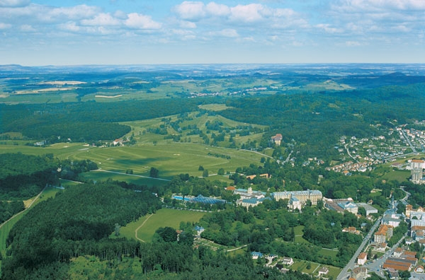
Vittel
Photo Credit: Nestlé Waters
Notes:
Vittel
In the 1980s, mineral water company Vittel (now a brand of Nestlé Waters) faced a critical problem. Nitrates and pesticides were entering the company‘s springs in northeastern France. Local farmers had intensified agricultural practices and cleared native vegetation that previously had filtered water before it seeped into the aquifer used by Vittel. This contamination threatened the company‘s right to use the ‗natural mineral water‘ label under French law. The Vittel brand and business were at stake.
Source: Perrot-Maître, D. 2006. The Vittel Payments for Ecosystem Services: A ‗Perfect‘ PES Case? London: International Institute for Environment and Development.

Slide 40
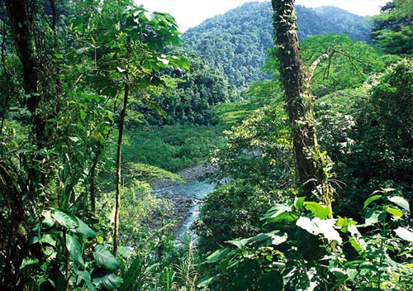

Energia Global (now Enel Latin America)
Notes:
Source: WRI, Ecosystem Services Review Standard Presentation, slides 2-5, http://www.wri.org/project/ecosystem-services-review/training
Background (cont.)
Facilitator 1 continued
Energia Global
Costa Rican hydropower company Energia Global (now Enel Latin America) faced a different crisis. In the 1990s, it was literally losing its source of power. Landowners were clearing the forested slopes upstream of the company‘s dams for livestock and agriculture. With the trees gone, heavy rains were causing increased soil erosion and river sedimentation, lowering dam reservoir capacity and power output.
Source: Malavasi, E.O. and J. Kellenberg. 2003. Program for Payments for Ecological Services in Costa Rica. Available at: http://www2.gsu.edu/~wwwcec/special/lr_ortiz_kellenberg_ext.pdf

Slide 41

Potlatch
Notes:
Potlatch, a U.S.-based wood products company, did not encounter a threat but rather an opportunity. For years, the company had managed its forests for timber. However, its 270,000 hectares of forest in Idaho were a popular destination for hikers, campers, birdwatchers, and hunters, drawing approximately 200,000 visitor-use-days per year. Recognizing an opportunity for a complementary source of revenue, the company introduced user fees in 2007 to capture the recreational value its forests provide.
Source: Maughan, R. ‗Potlatch Corp. to Charge Fees for Access to N. Idaho Forests‘ Seattle Post-Intelligencer. October 4, 2006.

Slide 42
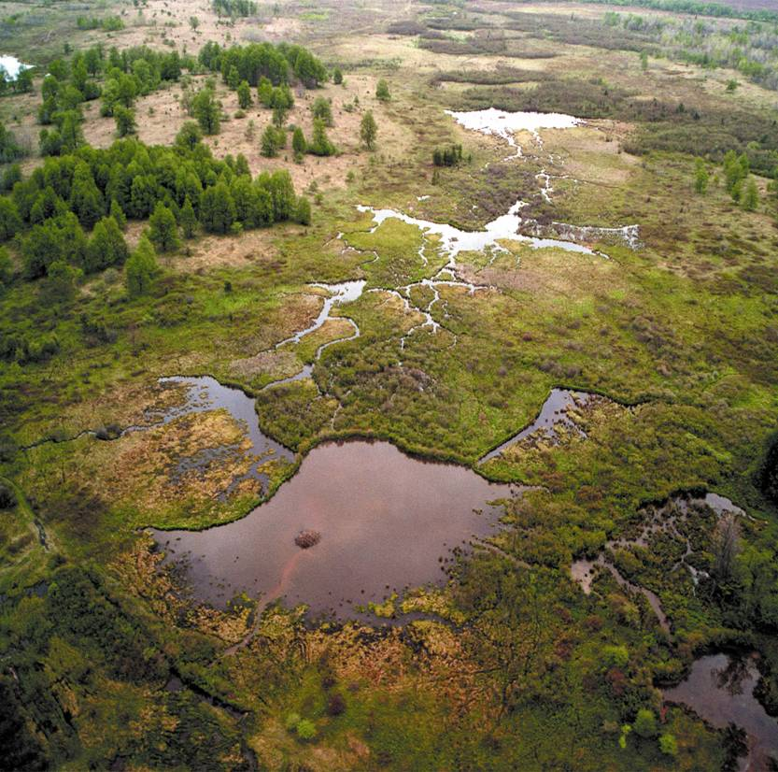
Allegheny Energy
Notes:
Allegheny Power
Allegheny Power had its own kind of opportunity. Earlier this decade, the U.S.-based electric utility wanted to divest its 4,800-hectare Canaan Valley property in West Virginia. Traditional approaches appraised the real estate at $16 million. Believing the property –with its pristine forests, marshes, and abundant wildlife –was worth more, the company commissioned an economic valuation of the marketable environmental benefits provided by the site, including its ability to sequester carbon and its wetlands.
The eco-assessment boosted the total value to nearly $33 million. Allegheny Power subsequently sold Canaan Valley to the U.S. government –which merged it with an existing wildlife refuge –for the traditional appraisal price of $16 million. Using ‗bargain sale‘ provisions in the federal tax code, however, the company was able to claim a charitable contribution of $17 million for the property‘s environmental value, yielding several million dollars in tax-related savings.
Source: Bayon, R. ‗Making Money in Environmental Derivatives‘ The Milken Institute Review, Q1 2002; Powicki, C.R. ‗Eco-Solutions Plays Key Role in Landmark Conservation Deal.‘ EPRI Journal Online. February 25, 2002; Lashley, D. 2003. Market Based Case Studies Involving Eco-Asset Management On Non-Mined Lands. GreenVest LLC.
What have all these cases have in common? Companies facing unexpected risks or novel opportunities arising from their dependence and impact on ecosystems
Vittel and Energia – Risk
Potlatch and Allegheny – Opportunity

Slide 43
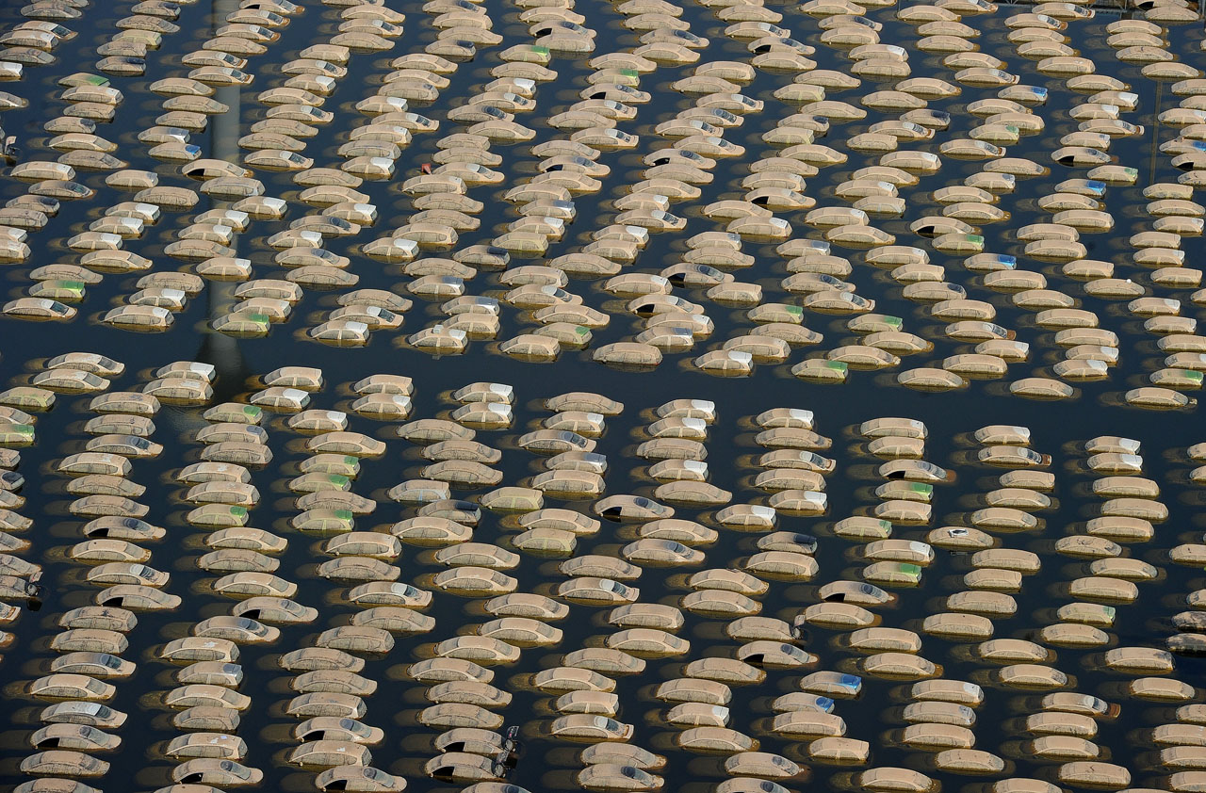
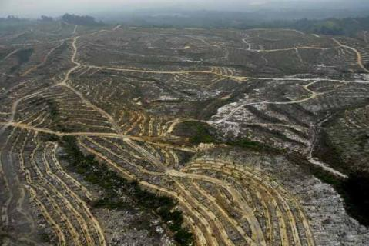
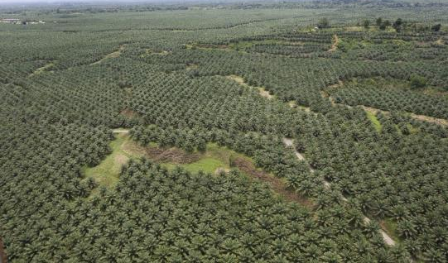
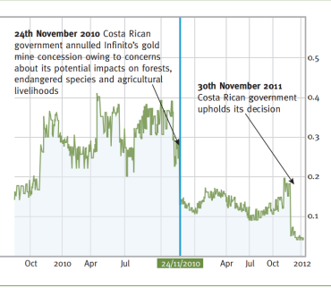
Risks & Opportunities
OPERATIONAL
E.g. Flooding of Honda factory
LEGAL
E.g. Concord Pacific fined $97 million after being found guilty of illegal logging in Papua New Guinea
Photo Credit: The Economist
REPUTATIONAL/ MARKETS
E.g. Mattel received over 500.000 customer complaints during Greenpeace campaign due to unsustainable packaging
FINANCIAL
E.g. Infinito Gold lost more than half of its value when the Costa Rican court annulled a gold mine concession
Notes:
In a world that is increasingly carbon and natural resource-constrained, global companies with strong brand positions face material risk as a direct result of biodiversity loss and ecosystem degradation. By the same token, these risks provide many new business opportunities.
Operational risks
Bangkok Honda factory >1000 cars. 2011 floods -> overall reduction of the country's economic growth by up to 1.7 percentage.
Nov. 26. 2011
The area is home to large production centers for global car and computer industries. According to Bloomberg, Toyota had to suspend local production of its Camry and Prius lines, and Apple faced delays in parts used for Mac computers. Western Digital shares hit a year low in October and is now working to regain their losses, according to Reuters. http://photoblog.nbcnews.com/_news/2011/12/27/9737801-honda-begins-scrapping-over-1000-cars-damaged-from-thailand-floods?chromedomain=worldnews
The World Bank has estimated 1,425 billion baht (US$45.7 Bn) in economic damages and losses due to flooding, as of 1 December 2011.^{[2][3]} Most of this was to the manufacturing industry, as seven major industrial estates were inundated by as much 3 meters (10 feet) during the floods.^{[4]} Disruptions to manufacturing supply chains affected regional automobile production and caused a global shortage of hard disk drives which lasted throughout 2012.^{[citation needed]}
http://www.travelfish.org/blogs/thailand/2011/10/26/what-caused-the-thai-floods/
Financial risks
Canadian gold mining company, Infinito Gold, lost over 50% of its share value as a result of the withdrawal of a mining concession in Costa Rica due to concerns about the potential impacts on agriculture, endangered species and forests. This led to a reference in the audit accounts to material uncertainties regarding the company’s ability to continue as a going concern
Source: KPMG, Flora and Fauna International, Acca, Is natural capital a material issue? (2012)
Reputational / Market risks
APP’s main pulp production base is Indonesia, and the division is responsible for around 40% of Indonesia's total pulp productionRecently, Mattel, the toy company behind Barbie, announced that they were cutting ties with APP and introducing new policies to remove deforestation from their supply chain (10).
On October 28th, the Dutch Advertising Code Commission ruled that APP’s TV and paper adverts, which attempt to position APP as a company that cares about the environment, are misleading the public (11).30-4-2014, Pulp & Paper (APP) Group announced it will commit to the protection and restoration of 1 million hectares of forest across Indonesia. Staples,which concluded that APP is a ‘great peril to our brand’ (9) as well global consumer goods companies such as Kraft, Nestle and Unilever.
International retailers such as Carrefour, Auchan, Metro Group and Tesco have all dropped APP from their own-brand products in the last two years, and sportswear giant Adidas has stopped business with APP too.

Slide 44

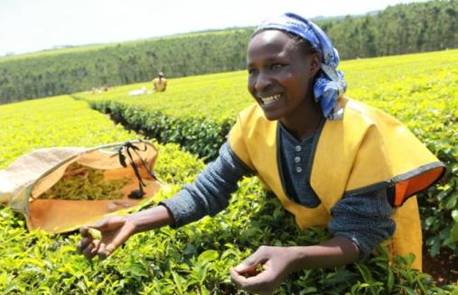
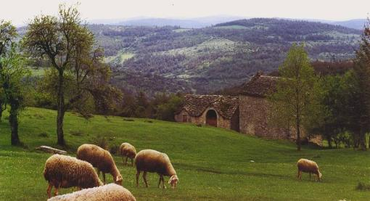
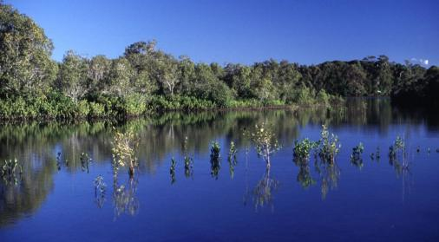
Risks & Opportunities
Walmart to save $150 Million in 2013 thanks to sustainability programs
Launch of Unilever’s Rainforest Alliance Certified tea: 12% grow in sale in Australia
Photo Credit: Unilever
Vittel has secured its license to operate by rewarding farmers for changing agricultural practices
Chevron could earn US$ 150 million potential income from selling wetland credits
Notes:
Risks also provide many new business opportunities.
Walmart
Walmart announced in Oct 2012 the company could save as much as $150 million during the company’s 2013 fiscal year due to several of its sustainability programs.
The announcement builds on Walmart’s recent achievements on reducing costs throughout its supply chain and operations. For example, by expanding waste diversion and recycling programs, Walmart reported it saved $231 million alone last year. Meanwhile the retailer has expanded solar and wind power generation at various sites across the United States.
Source: http://www.triplepundit.com/2012/10/walmart-save-150-million-sustainability-programs
Unilever
The launch of Unilever’s Rainforest Alliance Certified tea in Australia saw 12% growth in sales
Source: KPMG, Flora and Fauna International, Acca, Is natural capital a material issue? (2012)
Vittel
In the 1980s, mineral water company Vittel (now a brand of Nestlé Waters) faced a critical problem. Nitrates and pesticides were entering the company’s springs in northeastern France. Local farmers had intensified agricultural practices and cleared native vegetation that previously had filtered water before it seeped into the aquifer used by Vittel. This contamination threatened the company’s right to use the “natural mineral water” label under French law. The Vittel brand and business were at stake. Vittel decided to work with farmers to change their agricultural practices and a package of incentives was developed in collaboration with them (e.g. 200 Euros/ha/year over 5 years guaranteed income during the transition period; free technical assistance etc). The programme was ultimately successful. By 2004, all 26 farms in the area had adopted the new farming system and 92% of the sub-basin was protected.
Source: Perrot-Maître, D. 2006. The Vittel Payments for Ecosystem Services: A “Perfect” PES Case? London: International Institute for Environment and Development.
Chevron
US federal law mandates that developers who destroy wetlands must replace them by purchasing credits or shares in wetland mitigation banks—typically located in the same watershed—to offset ecological damage. Recognizing an opportunity, ChevronTexaco received approval in 2005 to convert a tapped-out drilling site in Louisiana into a 2,800-hectare wetland to generate credits for the US wetland mitigation banking market. At an expected market price of US$ 50,000 to US$ 62,000 per hectare, the company could earn more than US$ 150 million selling the credits to developers.
Source: Kenny, A. “Chevron Opens Mitigation Bank in Paradis(e).” Katoomba Group. Available at: http://ecosystemmarketplace.com/pages/article.news.php?component_id=4255&component_version_id=6132&language_id=12

Slide 45
Consider whether your:
Company operations are vulnerable to changes in the quality and quantity of ecosystem service inputs – e.g. water
Company license to operate is challenged by new stricter environmental policies and legislation – e.g. GHG emissions
Company reputation, brand or image is sensitive to public opinion and NGO actions about nature conservation – e.g. boycotts & campaigns
Company can respond to increased demand for green products from customers – e.g. eco-labelled and certified
Company faces biodiversity impact assessments when seeking external finance

Slide 46
RISKS AND OPPORTUNITIES FRAMEWORK
Business Issue
Operational
Market
Financing
Reputation
Legal
Notes:
Issues business can face in daily operations and supply chains:
Water scarcity and declining water quality
Disruption of food, fiber or other natural industrial inputs
Increasing incidents of extreme flooding, storms or drought
Increasing stakeholder expectations (NGOs, customers, investors etc.)
Tightened public policies on natural resource management or operational permitting
Traditional risk management processes do not always capture ecosystem risks / opportunities
There are 5 key areas of risks/opportunities for businesses to consider. These are listed in this slide.
Operational
Relate to a company’s day-to-day activities, expenditures and processes. Risks may be having to pay more for ecosystem dependencies such as water, and for environmental externalities such as pollution.
E.g. Blackouts in India 2012, 620 Ml. The late monsoon also meant that hydropower plants were generating less than their usual production.
Legal
Includes government policies and measures such as compliance laws, national targets, taxes and subsidies etc.
e.g Malaysian logging company Concord Pacific has been fined $97 million after being found guilty of illegal logging and causing environmental damage in Papua New Guinea
Vittel (1980s) and ’natural mineral water’ tag
Reputational
Effects on a company’s brand, image, “goodwill” and relationships with their customers and other stakeholders. For example, improving stakeholder relationships by committing to only procure palm oil that has been certified as sustainable.
Market and product
Relate to product and service offerings, consumer preferences, and other market factors that affect corporate performance. For example, releasing a new range of organic products or developing into the rapidly growing hybrid vehicle markets.
e.g. The global market for eco-labelled fish products has grown signficantly. From a retail value of US$ 1.5 billion in 2008 to US$3.2 bil in 2011.
Financing
Affect the cost and availability of capital to companies. For example, improving access to project finance loans by adhering to the “Equator principles” or a bank’s biodiversity policy. Canadian gold mining company, Infinito Gold, lost over 50% of its share value as a result of the withdrawal of a mining concession in Costa Rica due to concerns about the potential impacts on agriculture, endangered species and forests.

Slide 47
Exercise- The business case for action

Slide 48
Risks & opportunities
  Please discuss in groups: Which risks & opportunities could your company face as a result of a change in the ecosystem services that your business relies on or benefits from?
  You may do the exercise for an entire BU or specify a certain product, facility or supply chain.
  30 minutes

Slide 49
Business risks and opportunities
Type | Risk | Opportunity
Operational
Legal and political
Reputational
Market, product, replacement strategy
Financing
Notes:
49

Slide 50
CSI Business & Ecosystems Training
DAY 2
Bette Harms
Advisor Business & Biodiversity
Coordinator Leaders for Nature Academy

Slide 51
Session 9
Introduction to the Ecosystem Services Review

Slide 52
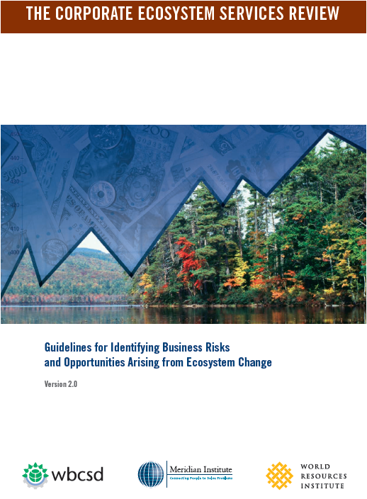
The Corporate Ecosystem Services Review (ESR)
    What is the ESR?
    A structured methodology that helps managers proactively develop strategies to manage business risks and opportunities arising from their company’s dependence and impact on ecosystems.
Notes:
The Corporate Ecosystem Services Review (ESR) is designed to help managers make the connection between the health of ecosystems and corporate performance.
The ESR consists of a structured methodology that helps managers proactively develop strategies to manage business risks and opportunities arising from their company‘s dependence and impact on ecosystems.
It is a tool for strategy development, not just for environmental assessment.

Slide 53
What the ESR is not
      It does not identify or address every environmental issue
      It is not strictly quantitative
      It is not dependent upon economic valuation of ecosystem services
      It does not require a long, multiyear analysis
Notes:
Background:
It does not identify or address every environmental issue. For instance, it does not provide an exhaustive inventory or quantification of a company‘s total environmental footprint, greenhouse gas emissions, water effluents, or toxic releases. Nor does it track a company‘s mineral or energy consumption.
It is not strictly quantitative. Quantitative information about a company‘s dependence and impact on ecosystem services or about trends in ecosystem services can be very useful when conducting a corporate ESR. However, quantitative information for some services is often sparse or nonexistent. Nevertheless, this shortcoming does not preclude a successful review. The road tests proved that qualitative analyses can be sufficient input for identifying many potential business risks and opportunities.
It is not dependent upon economic valuation of ecosystem services. The ESR does not require managers to estimate the economic value of each ecosystem service. Risks and opportunities arising from a company‘s dependence and impact on ecosystems can be identified through other approaches. Likewise, many strategies for addressing these risks and opportunities –such as making internal operational changes, launching new products, working with governments to develop new policies –do not require economic valuation of ecosystem services. Nevertheless, some companies may find that conducting an economic valuation of selected ecosystem services may be a valuable input to strategy development –as with the Allegheny Energy example covered earlier in the course. (for more background on ecosystem valuation please refer to Module 3)
It does not require a long, multiyear analysis. The time required to conduct an ESR will vary among companies and is a function of the scope chosen, the availability of data and the amount of staff involved in the review.

Slide 54
How can ecosystem service assessments help?
      Effective communication of complex and technical information
      Better informed decision-making
Identifying and prioritising business risks and opportunities
      Anticipating new markets and influencing policy development
      Improving stakeholder relationships
      Strengthening environmental management
Demonstrating leadership in corporate sustainability
Source: WRI, Ecosystem Services Review Standard Presentation

Slide 55
Steps in a corporate ecosystem services review
1. Select the scope
2. Identify priority ecosystem services
3. Analyze trends in priority services
4. Identify business risks and opportunities
1. Select the scope
2. Identify priority ecosystem services
3. Analyze trends in priority services
4. Identify business risks and opportunities
5. Develop strategies
Step
Key activity
Choose boundary within which to conduct ESR Business unit Product Market Landholdings Customer Supplier | Systematically evaluate degree of company’s dependence and impact on ecosystem services Determine highest ‘priority’ services – those most relevant to business performance | Evaluate conditions and trends in priority ecosystem services, as well as drivers of these trends | Identify and evaluate business risks and opportunities that might arise due to the trends in priority ecosystem services | Outline and prioritize strategies for managing the risks and opportunities
Estimated time
1-2 weeks
1-2 weeks
2-5 weeks
1-2 weeks
1-2 weeks
Source: WRI, Ecosystem Services Review Standard Presentation

Slide 56
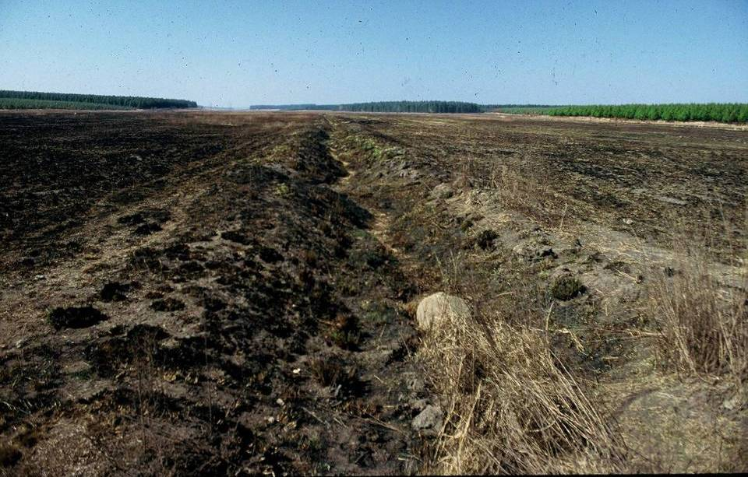
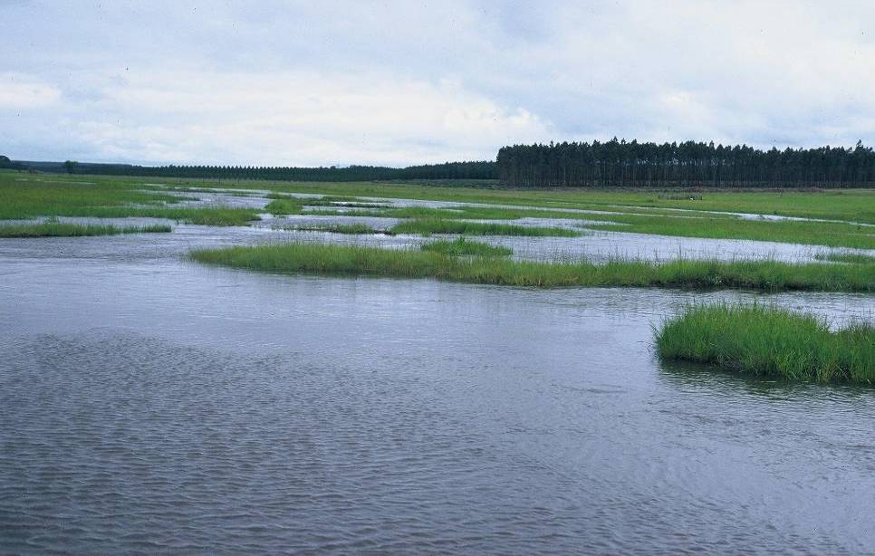
Case study: Mondi
The issue: High water dependency
      Mondi
        Integrated paper and packaging producer, owns plantations in South Africa
      South Africa
        Fresh water, a scarce resource
        55% of South Africa’s wetlands to date have been significantly damaged due to poorly managed agriculture; mining, urban development, etc.
Before
      Because Mondi’s commercial activities (commercial forests and processing plants) use significant volumes of water, it relies on healthy wetlands and riparian zones.
After
      Mondi used the ESR to develop a corporate-wide strategy for addressing water scarcity in its South African plantations.
Example of wetland rehabilitation carried out by Mondi in South Africa

Slide 57
Step 1. Considerations when selecting the scope
1. Which stage of the value chain?
Suppliers
Company
Customers
2. Who and where specifically?
Which supplier(s)? In which geographic market(s)? | What aspect of the company? Business unit Product line Facility Project Landholdings | Which customer(s)? In which geographic market(s)?
3. Is it strategic, timely, and supported?
Source: WRI, Ecosystem Services Review Standard Presentation
Notes:
Background:
The first step is to select the ‗scope‘ of the ESR. The purpose of this step is to define clear boundaries within which to conduct the analysis in order to keep the process manageable and yield more actionable results. Three questions can help managers select an ESR scope:
Which stage of the value chain?An ESR could focus on a company‘s own operations, providing insight into the direct implications that trends in ecosystem services would pose for the company. One alternative is to look ‗upstream‘ in the value chain to shed light on the implications of ecosystem service trends for key suppliers and the business risks and opportunities that these, in turn, may pose to the company conducting the ESR. Another alternative is to look ‗downstream‘ at a major customer segment.
Who and where specifically?If conducting the ESR on the company itself, then select a certain aspect of the business. Options include a particular business unit, product line, facility, project, or natural asset owned by the company.
[Interactive option, facilitator 2 to add delegate questions and note answers on a flip chart ] If the ESR is focused on key suppliers, then choose a specific supplier or category of suppliers and perhaps further narrow the scope by selecting a particular geographic market in which these suppliers operate. Do likewise if focused on major customers.
Is the candidate scope strategic, timely, and supported? The scope should be of high strategic importance to the company. Examples include the company‘s fastest growing market, an upcoming major product line, or the business unit with the greatest market share. The scope should offer a window of opportunity for the ESR to influence upcoming important business decisions. In addition, there should be sufficient internal management support for conducting an ESR within the selected scope.

Slide 58
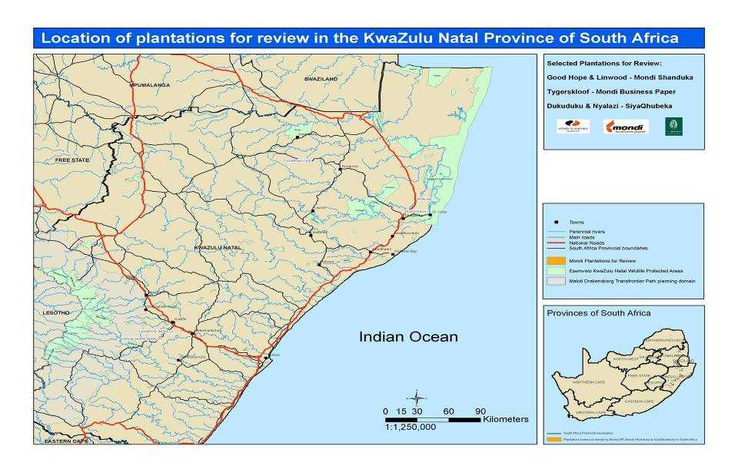
Case study example: Mondi (cont.)
The result
      ESR Scope:
        3 of Mondi’s South African pine and eucalypt plantation areas (Shanduka, SiyaQhubeka, and Tygerskloof)
        One plantation, SiyaQhubeka, is adjacent to a UNESCO World Heritage site, and the company wanted to explore opportunities for biodiversity enhancement and ecotourism.
      Used the Dependence & Impact Assessment Tool to select six priority ecosystem services:
        Freshwater.
        Water regulation.
        Biomass fuel.
        Global climate regulation.
        Recreation and ecotourism.
        Livestock.

Slide 59
Step 2. Identifying priority ecosystem services
Suppliers
Company operations
Customers
Ecosystem service | Dependence | Impact | Dependence | Impact | Dependence | Impact
Provisioning
Crops |  |  |  | ○ –
Livestock |  |  |  | ● –
Capture fisheries
Aquaculture
Wild foods |  |  |  | ○ +
Timber and other wood fiber |  |  |  | ● +
Other fibers (e.g., cotton, hemp, silk)
Biomass fuel |  |  | ○ | ● +
Freshwater |  |  | ● | ● –
Genetic resources |  |  | ○ | ○ ?
Biochemicals, natural medicines, and pharmaceuticals |  |  |  | ○ +
Key:  High ○ Medium Low + Positive impact – Negative impact ? Don’t know
Source: WRI, Ecosystem Services Review Standard Presentation
Notes:
The second step is to evaluate in a structured yet rapid manner the company‘s dependence and impact on more than 20 ecosystem services. This evaluation will help identify which of these are ‗priority‘ services –the ones most likely to be a source of risk or opportunity for the company. These priority ecosystem services are the focus of analysis in subsequent steps; the other services are screened out.
To identify its priority services, a company needs to understand its level of dependence and impact on each ecosystem service. This is because the ecosystem services that are sources of business risk or opportunity typically are those that the company highly depends upon and/or highly impacts. For instance, if a company highly depends upon an ecosystem service and that service becomes scarce or degrades, then the company may face business risk in the form of higher input costs or disruption to its operations. If a company negatively impacts an ecosystem service by depleting or degrading it, then the company‘s actions may pose regulatory or reputational business risks.
Conversely, if a company positively impacts an ecosystem service by supplying or enhancing it, then the company‘s actions may give rise to possible new business opportunities or reputational benefits.
The ESR has a spreadsheet tool that asks users 5 questions per ecosystem service in order to determine the degree to which a company depends upon and impacts each service. The tool then translates the answers into a simple summary matrix (example shown) that helps managers identify which 5-7 services are the priority services.

Slide 60
Step 2. Identifying priority ecosystem services (cont.)
Suppliers
Company operations
Customers
Ecosystem service | Dependence | Impact | Dependence | Impact | Dependence | Impact
Regulating
Air quality regulation |  |  |  | ? ?
Global climate regulation |  |  | ○ | ● +
Regional/local climate regulation |  |  | ○ | ○ +
Water regulation |  |  | ● | ● –
Erosion regulation |  |  | ○ | ○ –
Water purification and waste treatment |  |  |  | ○ –
Disease regulation
Pest regulation
Pollination
Natural hazard regulation
Cultural
Recreation and ecotourism |  |  |  | ● +
Ethical values |  |  |  | ○ +
Key:  High ○ Medium Low + Positive impact – Negative impact ? Don’t know
Source: WRI, Ecosystem Services Review Standard Presentation

Slide 61
Step 3. Ecosystem service trends and drivers framework
Condition and trends in the ecosystem service
Supply and demand Quantity and quality Present and future
Company activities
Who – the company How Where To what degree
Direct drivers
Changes in land use and land cover Overconsumption Climate change Pollution Invasive, non-native species Other
Activities of others
Who – stakeholders How Where To what degree
Indirect drivers
Governmental Demographic Economic Technological Cultural and religious
Source: WRI, Ecosystem Services Review Standard Presentation
Notes:
Background:
The third step is to research and analyze the status and trends in the priority ecosystem services that were identified in step 2. The purpose of this research is to provide managers with a sufficient amount of relevant information and insights so that they can later identify business risks and opportunities that may arise from these trends.
For the trends analysis, managers should conduct research to answer the following five questions for each of the ecosystem services identified as a priority:
What are the conditions and trends in the supply and demand for the ecosystem service?
What direct drivers underlie these trends?
What is the company‘s contribution to these drivers?
What is the contribution of others to these drivers?
What indirect divers underlie these trends?

Slide 62
Some Concepts
      Ecosystem Dependency: “Environmental conditions required for successful corporate performance”, e.g. the agricultural industry is dependent on plant pollinator species such as bees.
      Ecosystem Impact: “Company affects the quantity or quality of the ecosystem service”, e.g. mining industry has an impact on ecosystems that exist on the land occupied by extraction sites.
      Ecosystem Priority: “those services on which the company has a high dependence and/or impact”, e.g. the paper industry impacts on forests by procuring timber for their products.
      Drivers: “factors–natural or man-made–that cause changes in an ecosystem and its ability to supply ecosystem services”.

Slide 63
Step 4. Types of risks and opportunities arising from trends in ecosystem services
Not Exhaustive
Type | Risk | Opportunity
Operational | Increased scarcity or cost of inputs Reduced output or productivity Disruption to business operations | Increased efficiency Low-impact industrial processes
Regulatory and legal | Extraction moratoria Lower quotas Fines User fees Permit or license suspension Permit denial Lawsuits | Formal license to expand operations New products to meet new regulations Opportunity to shape government policy
Source: WRI, Ecosystem Services Review Standard Presentation
Notes:
Background:
The fourth step is to evaluate the implications for the company arising from trends in their priority ecosystem services. The purpose of this step is to identify the business risks and opportunities that might develop from these trends.
Start by holding a structured brainstorming session to identify the business risks and opportunities that the trends identified in step 3 might pose for the company. To help trigger ideas, systematically consider each of the five types of risk and opportunity against each priority service.
Once completed, move on to the next priority ecosystem service and go through the same process, continuing until all priority services have been covered.
Desk research can supplement the results of the brainstorming session

Slide 64
Step 4. Types of risks and opportunities arising from trends in ecosystem services (cont.)
Not Exhaustive
Type | Risk | Opportunity
Reputational | Damage to brand or image Challenge to social ‘license to operate’ | Improved or differentiated brand
Market and product | Changes in customer preferences (public sector, private sector) | New products or services Markets for certified products Markets for ecosystem services New revenue streams from company-owned or managed ecosystems
Financing | Higher cost of capital More rigorous lending requirements | Increased investment by progressive lenders and socially responsible investment funds
Source: WRI, Ecosystem Services Review Standard Presentation

Slide 65
Case study example: Mondi (cont.)
Priority ecosystem service | Potential risks | Potential opportunities | Type of risk/opportunity
Freshwater | Increased water scarcity due to: Invasive alien species Increasing demand among nearby, inefficient water users (farmers) Climate change | Internal efficiency improvements in freshwater use (Co)financing water efficiency improvements of nearby landowners | Operational
Water regulation | See above
Biomass fuel |  | New biomass-to-energy markets for plantation residues | Market and product
Global climate regulation |  | Emerging markets for carbon sequestration | Market and product
Recreation and ecotourism |  | Ecotourism or recreation-based revenue streams from company-managed wetlands/grasslands | Market and product
Livestock | Reduced plantation productivity due to increasing grazing pressures |  | Operational
 | Increases scrutiny from nearby stakeholders for perceived “under-utilization” of Mondi land set aside as wetlands/grasslands |  | Reputational
The result (cont.)

Slide 66
Step 5. Categories of strategies
Internal changes
Sector or stakeholder engagement
Policy-maker engagement
      Operations
      Product strategy
      Market strategy
      Procurement strategy
      Land management
      etc.
      Industry peer collaboration
      Cross-sector collaboration
      NGO collaboration
      Transactions with stakeholders
      etc.
      Tax incentives
      Subsidy reforms
      Protected areas
      Zoning
      etc.
Source: WRI, Ecosystem Services Review Standard Presentation
Notes:
Background:
The fifth step is to develop and prioritize strategies for minimizing the risks and maximizing the opportunities identified during step 4. Once the fifth step has been completed, managers will have a prioritized set of strategies to implement.
Strategies for responding to ecosystem service-related risk and opportunities fall into three broad categories:
Internal changes. Companies can address many of the risks and opportunities through changes in operations, product/market strategies, and other internal activities. Potlatch, for instance, developed a strategy to establish a new revenue stream from its forests through visitor user fees.
Sector or stakeholder engagement. Companies can also address some of these risks and opportunities by partnering with industry peers, collaborating with other sectors, or structuring transactions with stakeholders.
Vittel, for instance, addressed its water contamination problem by paying farmers in the watershed to switch to more sustainable land use practices and restoring the ecosystems surrounding the springs.
Policy-maker engagement. Another productive corporate strategy for addressing some ecosystem service-related issues can be to engage policy-makers and government agencies to establish good policies. Companies can voice support for (or provide input to) incentives or effective rules for sustainable management of ecosystem services.

Slide 67
Case study example: Mondi (cont.)
The result (cont.)
      The ESR:
        Highlighted the relationship among many of the known drivers of water scarcity (e.g., invasive species, climate change, poor irrigation by upstream users).
        Expanded the analysis beyond the scope of the existing environmental management systems to include systematic reviews of more ecosystem services such as biomass fuel and ecotourism.
        This uncovered new solutions and a platform for building a freshwater strategy stretching from the plantation management to community engagement, and even to their government relations divisions.

Slide 68
Session 11
Exercise– applying the ESR

Slide 69
Group exercise: impacts/dependency questionnaire
      Using the two tables provided on the wall charts, analyse how your company impacts and depends upon different ecosystem services.
      Select a scope for your group, for example a specific site, value chain or customer.
      30 minutes
      15 minutes for sharing findings

Slide 70
Group exercise
Dependence on ecosystem services
Ecosystem service | 1. Does this ecosystem service serve as an input or does it enable/enhance conditions for successful company performance? If ‘no’ skip to question 3 | 2. Does this ecosystem service have cost-effective substitutes? | Comments or supporting information

Slide 71
Group exercise
Impacts on ecosystem services
Ecosystem service | 3. Does the company affect the quantity or quality of this ecosystem service? If ‘no’ skip to the next ecosystem service | 4. Is the company’s impact positive or negative?(ª) | 5. Does the company’s impact limit or enhance the ability of others to benefit from this ecosystem service? | Comments or supporting information
Note: (ª) Positive impact: The company increased the quantity or quality of this ecosystem service.
Negative impact: The company decreased the quantity or quality of this ecosystem service.

Slide 72
CLARIFICATIONS AND QUESTIONS

Slide 73
Key References
      IUCN Business and Biodiversity Program http://www.iucn.org/about/work/programmes/business/ and http://cmsdata.iucn.org/downloads/nature_is_our_business_web_version.pdf
      IUCN Asia Business and Biodiversity http://www.iucn.org/about/union/secretariat/offices/asia/elg/bbp/
      IUCN NL Leaders for Nature http://www.leadersfornature.nl/ and http://vimeo.com/67058556
      IUCN and Holcim Biodiversity relationship http://www.iucn.org/about/work/programmes/business/bbp_work/by_engagement/bbp_holcim/
      WBCSD. BET - Business Ecosystems Training - http://www.wbcsd.org/bet.aspx
      WBCSD; IUCN; WRI, ERM, PWC Guide to Corporate Ecosystem Valuation (CEV) http://www.wbcsd.org/work-program/ecosystems/cev.aspx
      WRI; WBCSD, Meridian: Corporate Ecosystem Services Review http://www.wri.org/project/ecosystem-services-review
      WBCSD. Responding to the Biodiversity Challenge: Business contributions to the Convention on Biological Diversity – http://www.wbcsd.org/work-program/ecosystems/ecosystems-training-tools.aspx
      WBCSD. Vision 2050 and Pathways to 2050
      Millennium Ecosystem Assessment. 2005. Ecosystems and Human Well-being: Opportunities and Challenges for Business and Industry – http://www.maweb.org/documents/document.353.aspx.pdf
      Millennium Ecosystem Assessment, 2005. Ecosystems and Human Well-being: Synthesis – http://www.maweb.org/documents/document.356.aspx.pdf
      TEEB – http://www.teebweb.org/
      TEEB for business – http://www.teebweb.org/Portals/25/Documents/TEEB%20for%20Business/TEEB%20for%20Bus%20Exec%20English.pdf

Slide 74
Disclaimer
Business Ecosystems Training (BET) is a capacity building program released in the name of the WBCSD. It is the result of a collaborative effort by members of the secretariat and senior executives from KPMG and an Advisory Committee composed of member companies, Regional Network partners, NGOs, UN and academic institutions, and others. A wide range of members reviewed drafts, thereby ensuring that BET broadly represents the majority of the WBCSD membership. It does not mean, however, that every member company agrees with every word.
Business Ecosystems Training (BET) has been prepared for capacity building only, and does not constitute professional advice. You should not act upon the information contained in BET without obtaining specific professional advice. No representation or warranty (express or implied) is given as to the accuracy or completeness of the information contained in BET and its translations in different languages, and, to the extent permitted by law, WBCSD, KPMG, members of the Advisory Committee, their members, employees and agents do not accept or assume any liability, responsibility or duty of care for any consequences of you or anyone else acting, or refraining to act, in reliance on the information contained in this capacity building program or for any decision based on it.
Copyright © World Business Council for Sustainable Development
December 2012

